Slide 1
Availability Groups in 10 Min aka HADRON was a cooler name
William Assaf

Slide 2
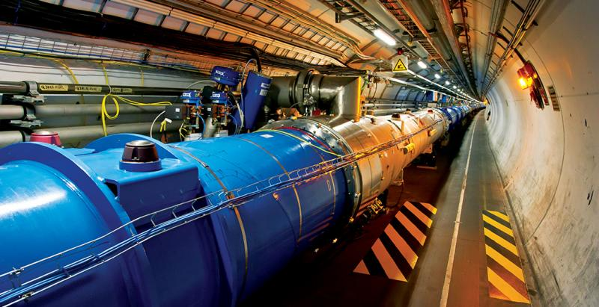
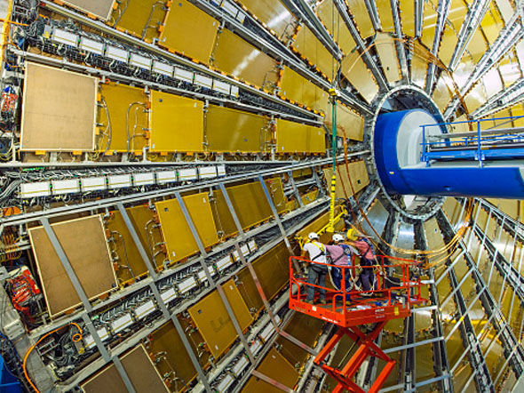
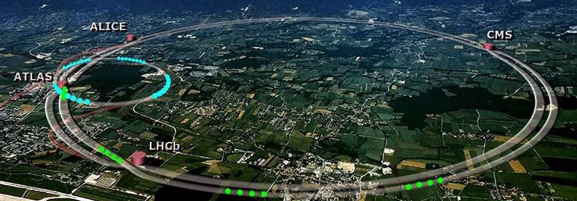
HADRON
Large Hadron Collider
17 mile-across circle beneath the France–Switzerland border near Geneva.
Most complex experimental facility ever built
Largest machine in the world
After decades of work, first research took March 2010

Slide 3


As we all know, the LHC ripped apart our space-time continuum and everything started getting awful around 2016

Slide 4
What else was going on in 2010?
SQL Server 2008 R2 released July 2010¹
Code name Denali (what would become SQL Server 2012) was in development, CTP 1 released in Nov 2010²
1 https://blogs.msdn.microsoft.com/sqlreleaseservices/end-of-mainstream-support-for-sql-server-2008-and-sql-server-2008-r2/
2 https://blogs.technet.microsoft.com/sqlman/2010/11/09/microsoft-sql-server-code-named-denali-community-technology-preview-1-ctp1/

Slide 5
FCI’s and Mirroring
Before SQL Server 2012, we needed a better way to deliver high availability automatic failovers.
Existing options for High Availability (HA) required secondary servers that weren’t much use, higher complexity, or third-party products.

Slide 6
Our HA Options Prior to SQL 2012
FCI (Failover Cluster Instance) – a single clustered instance that lives on one of many Windows Servers in a Failover Cluster (WSFC). Higher complexity involved shared storage.
Mirroring – database level replication between exactly two SQL instances – can’t use the secondary instance’s database, it is not online.

Slide 7
Dream Featureset
A new feature was developed with many advantages
Simpler setup/architecture in Windows
Database-level sync between two SQL Server instances, but let us read from the secondary
Allow backups, error detection on both sides
Automatic failover with a listener
New monitoring/DMV’s/wizards, no reuse of Mirroring
PowerShell or TSQL for everything

Slide 8
H.A.D.R.ON
High Availability
Automatic database (not instance) failover
Disaster Recovery
Take backups on any replica, even if far apart geographically, avoid network bandwidth xfer
Online
Secondary replicas actually have a use – they’re ONLINE, so you can offload read-heavy reporting workloads and read-only queries to them!

Slide 9

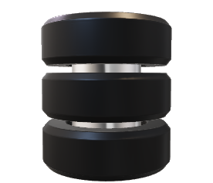
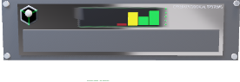
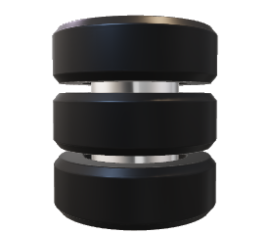

LISTENER
Application Intent Read-Only
Application Intent Read-Write
Database1
Database1
PRIMARY
SECONDARY
WSFC Network Keeps Quorum
SQL Instance 1 on
Windows Server 1
SQL Instance 2 on
Windows Server 2

Slide 10
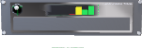
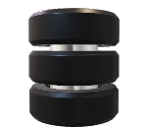
LISTENER
Application Intent Read-Only
Application Intent Read-Write
Database1
Database1
PRIMARY
WSFC Network Keeps Quorum
SQL Instance 1 on
Windows Server 1
Up to 8 secondary replicas
across multiple subnets!

Slide 11
“AlwaysOn”
So, Microsoft’s marketing goons dumped HADRON.
“AlwaysOn” is now a marketing-only umbrella name for both the FCI and AG technologies. “AlwaysOn” technically refers to two architectures: one old, one new.
We’re just lucky it’s not called Power something.
PowerPoint, PowerPivot, PowerView, PowerQuery, PowerMap, PowerShell, PowerApps, PowerBI… defective Surface Power Cord…

Slide 12
NOT DAG
“AlwaysOn” Availability Groups may be the marketing name, but we just call it “Availability Group” or “AG”.
In secret DBA rooms, we still call it HADRON because it’s cool. (Some of the internals still use HADRON or HADR!)
We NEVER call it “DAG”. DAG is a Microsoft Exchange term for a totally different technology. Don’t call it DAG.

Slide 13
Availability Groups Possibilities
Enterprise Edition Availability Groups (typical, since SQL 2012)
Synchronous/Async, Automatic Failover possible
Cross-OS possible using WSFC on Windows or Pacemaker on Linux
Basic Availability Groups (Introduced in SQL 2016 Standard edition)
Replaces Mirroring: 2 nodes, secondary replica can’t be used
Distributed Availability Groups (Introduced in SQL 2016)
AG treats another AG as a replica (over WAN), up to 17(!) replicas
Clusterless (!!!) Availability Groups (Introduced in SQL 2017) …

Slide 14
Clusterless Availability Groups
New in SQL 2017. Does not require a WSFC! No quorum! Hooray!
Cross-OS: Win+Win, Win+Linux, Linux+Linux
No automatic failover, manual failover possible
Full-featured, readable sync/async replicas
Create SQL-based listener, so Read-Only Routing possible
Referred to as “Read-scale availability groups” by MS

Slide 15
Availability Groups Features
Automatic Seeding (first introduced in SQL 2016) has more improvements, including speed and stability:
Now file paths on each replica don’t need to match (but they should!)
Automatic seeding is fast, easy way to stream data to secondary replicas, without a restore or a network share.
It performs a backup using the Mirroring endpoint as a virtual backup device, and can compress the data transfer to reduce network usage.

Slide 16
Availability Groups Features
Distributed transaction support:
SQL 2016 introduced support for distributed transactions using DTC for databases on different instances.
SQL 2017 allows for cross-database transactions using DTC for databases on the same or different instances.
SQL 2017 now uses DTC even when databases in an availability group in the same instance of SQL Server
New syntax needed to support setup of the Availability Group: DTC_SUPPORT = PER_DB

Slide 17
Monitoring insight built-in
Tons of internal metrics about AG performance, health
Measure the delay of synchronous mode vs asynchronous
Samples:
https://github.com/williamadba/sql-server-toolbox/tree/master/Availability%20Groups

Slide 18
Azure SQL Offerings
Availability Groups are IaaS only, not for PaaS:
Azure SQL Databases
-or-
Azure SQL Database Managed Instances (preview)¹
Both cloud-first technologies have High Availability built-in, cannot join an IaaS AG.
1 https://docs.microsoft.com/en-us/azure/sql-database/sql-database-managed-instance

Slide 19
Azure SQL Offerings
For Azure SQL Databases, Geo-Replication of your data is literally a few clicks. And Read-only Replica Scale-Out is available (in preview).¹
For Azure SQL Managed Instance (still in preview), High Availability is built-in, and based on Azure Service Fabric.²
1 https://docs.microsoft.com/en-us/azure/sql-database/sql-database-read-scale-out
2 https://docs.microsoft.com/en-us/azure/sql-database/sql-database-managed-instance

Slide 20




HEALTH CHECK
REMEDIATION
MANAGED SQL
The Sparkhound SQL DBA Team
Knowledge Transfer – We work with your Devs, DBA’s, “accidental” DBA’s.
Pros Nearby – Sparkhound’s DBA team of FTE’s are US-based, CT zone.
Microsoft & Peer Recognized – Sparkhound DBA team is 100% Microsoft certified, and members have spoken at conferences and user groups.
Proven Success – For years we have supported servers in US and Europe.
Dev Background – Experience as former developers provides context.
The Checklist - Reference for future checks, audit prep, new SQL builds.

Slide 21
Sparkhound Managed SQL
HEALTH CHECK
REMEDIATION
MANAGED SQL
Interactive Health Check
Windows, SQL, Process
Remediation
Planning
Proactive Health Checks
Reactive Alerting
Regular Maintenance Windows
Knowledge Transfer
Special Project Assistance
Documentation/Process Improvement
Trending/Analysis
Checklist
Critical
High
Medium
Low
Checklist
Maintenance
Window
Managed Services
Emphasis on Knowledge Transfer
What, Why, How

Slide 22
Sparkhound SQL DBA Consulting Services
Performance Tuning, with App Services team
Reporting, with our Data Analytics team
Upgrades/Migrations/Data Conversions
High Availability/Disaster Recovery solutions
Pre-audit, encryption, database security
Maintenance/administration
Automation/PowerShell
Azure SQL (IaaS or PaaS) architecture
Training/Knowledge Transfer/skillset updates

Slide 23
Bio and contact
William D Assaf, MCSE
Baton Rouge SQL Server UG board and SQLSaturday chair
Author, Microsoft SQL Server 2017 Administration Inside Out
https://amazon.com/gp/product/1509305211
Principal Consultant, Manager – DBA Team at
Sparkhound Baton Rouge
William.Assaf@sparkhound.com
Twitter: @william_a_dba
This presentation, including all source code and this slide deck, has been posted at my blog:
SQLTact.com

